Slide 1
Exploring Equivalent Fractions
EQ – What are equivalent fractions?
Mrs Stretch
Year 7

Slide 2
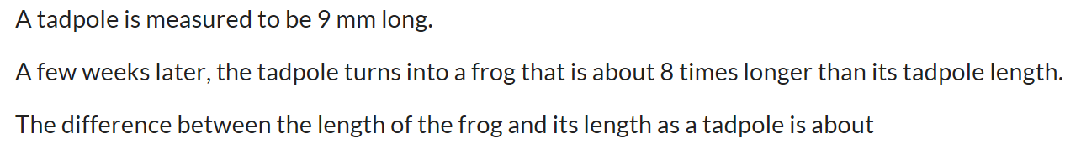
Exploring Equivalent Fractions
EQ – What are equivalent fractions?
What is the perimeter of a shape?
Round the decimal to 3 d.p = 64.356
Multiply the following 25 x 30 (don’t use calculator)
Add the two fractions ½ + ½

Slide 3

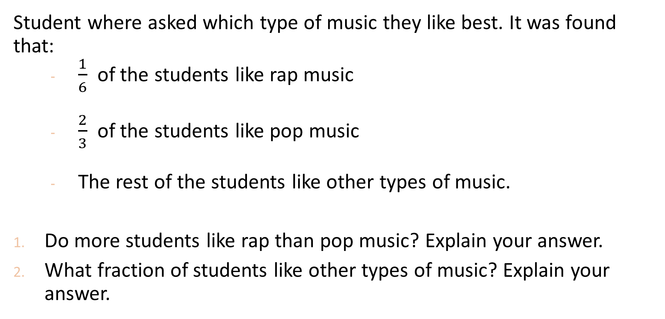
Starter Activity
Student where asked which type of music they like best. It was found that:
  $\frac{1}{6}$ of the students like rap music
  $\frac{2}{3}$ of the students like pop music
  The rest of the students like other types of music.
Do more students like rap than pop music? Explain your answer.
What fraction of students like other types of music? Explain your answer.

Slide 4
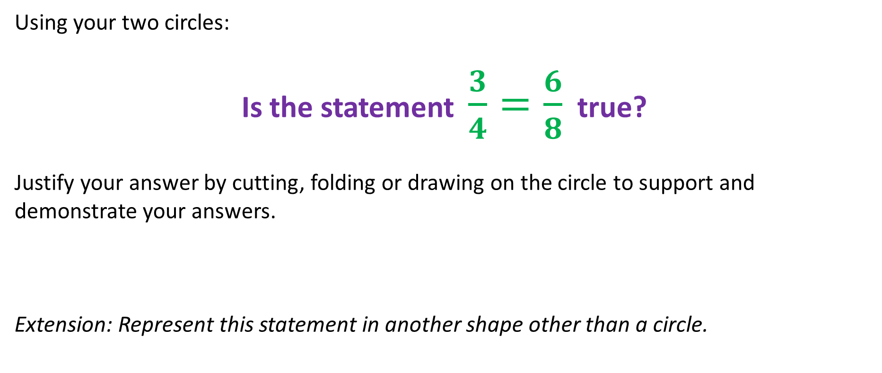
Task Side: Activity One
Using your two circles:
Is the statement $\frac{3}{4}=\frac{6}{8}$ true?
Justify your answer by cutting, folding or drawing on the circle to support and demonstrate your answers.
Extension: Represent this statement in another shape other than a circle.
Notes:
Each student gets two circles.
Students may explain that the fractions, three quarters and six eights represent the same amount of pizza.
Some can explain the concrete representation of the fractions but not understand the representation.
Ask the students what these fractions are called.

Slide 5
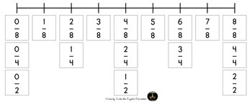
24
7
30
Equivalent Fractions
Date
EQ – What are equivalent fractions?
What is a equivalent fraction?
They are fractions that mark the same place on a number line.

Slide 6
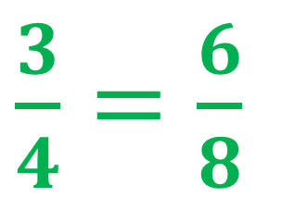
24
7
30
Equivalent Fractions
Date
EQ – What are equivalent fractions?
What happens to the size of the pieces and the number of pieces when the quarters are divided into eighths?
$\frac{3}{4}=\frac{6}{8}$
How can I explain this in words?
The number of pieces is doubled when the three pieces of pizza become six pieces.
The size of the pieces is halved.
Notes:
Students may explain that when quarters of a pizza are partitioned into eighths, the size of the pieces is halved and the number of pieces is doubled.

Slide 7
24
7
30
Equivalent Fractions
Date
EQ – What are equivalent fractions?
How can I explain this in words?
The number of pieces is doubled when the three pieces of pizza become six pieces.
The size of the pieces is halved.
Notes:
Students may explain that when quarters of a pizza are partitioned into eighths, the size of the pieces is halved and the number of pieces is doubled.

Slide 8

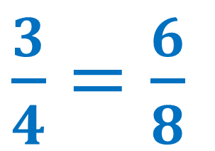
24
7
30
Equivalent Fractions
Date
EQ – What are equivalent fractions?
x 2
How can I explain this mathematically?
The numerator: amount of pizza pieces double
$\frac{3}{4}=\frac{6}{8}$
$\frac{3}{4}=\frac{6}{8}$
The denominator: the size of each pizza halves
x 2
Notes:
1. Explain to students how this is represented with numbers. The numerator, 3, of 3/4 that represents the three pieces of pizza is multiplied by 2 to become 6 pieces of pizza in 6/8.
2. Explain how this is represented with numbers. The denominator, 4, of 3/4 indicates the size of each piece of pizza is one quarter. When 4 is multiplied by 2 to become 8 in 6/8 the 8 indicates the size of each piece of pizza is one eighth.

Slide 9
If the number of pieces of pizza is two times greater and the size of each piece is two times smaller, the amount of pizza will remain the same.
Therefore they are equivalent fractions

Slide 10


Slide 11
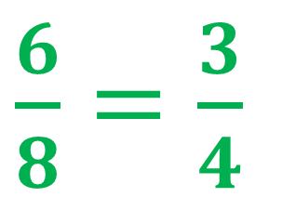
24
7
30
Equivalent Fractions
Date
EQ – What are equivalent fractions?
Can we go the other way?
How can I explain this in words?
$\frac{6}{8}=\frac{3}{4}$
The number of pieces is halved when the six pieces of pizza become three pieces.
The size of the pieces is doubled.
Notes:
Students may explain that when quarters of a pizza are partitioned into eighths, the size of the pieces is halved and the number of pieces is doubled.

Slide 12
24
7
30
Equivalent Fractions
Date
EQ – What are equivalent fractions?
How can I explain this in words?
The number of pieces is halved when the six pieces of pizza become three pieces.
The size of the pieces is doubled.
Notes:
Explain how this is represented with numbers. The numerator, 6, of 6/8 that represents six pieces of pizza is divided by 2 to become 3 pieces of pizza in 3/4.
The denominator, 8, of 6/8 indicates the size of each piece of pizza is one eighth. When 8 is divided by 2 to become 4 in 3/4 the size of each piece of pizza is one quarter.

Slide 13
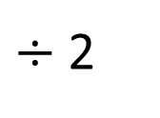
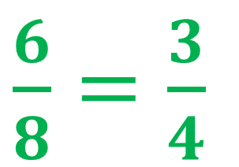
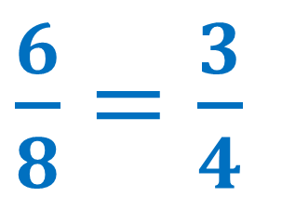
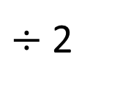
24
7
30
Equivalent Fractions
Date
EQ – What are equivalent fractions?
$÷$ 2
How can I explain this mathematically?
The numerator: amount of pizza pieces is halved
$\frac{6}{8}=\frac{3}{4}$
$\frac{6}{8}=\frac{3}{4}$
The denominator: the size of each pizza doubles
$÷$ 2
Notes:
Explain how this is represented with numbers. The numerator, 6, of 6/8 that represents six pieces of pizza is divided by 2 to become 3 pieces of pizza in 3/4.
The denominator, 8, of 6/8 indicates the size of each piece of pizza is one eighth. When 8 is divided by 2 to become 4 in 3/4 the size of each piece of pizza is one quarter.

Slide 14

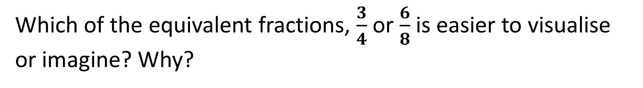
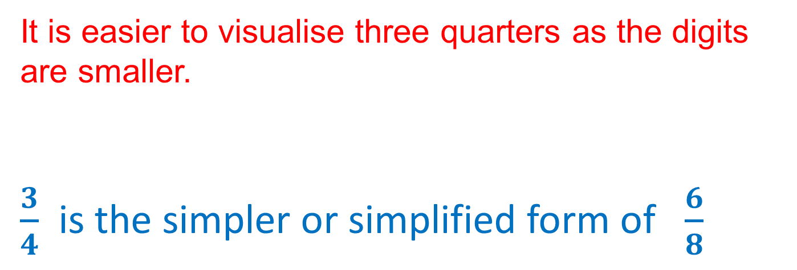
Which of the equivalent fractions, $\frac{3}{4}$ or $\frac{6}{8}$ is easier to visualise or imagine? Why?
It is easier to visualise three quarters as the digits are smaller.
$\frac{3}{4}$ is the simpler or simplified form of $\frac{6}{8}$
Notes:
Explain to students that because the digits, 3 and 4, in the number 3/4 are smaller than the digits, 6 and 8, in the number 6/8 , 3/4 is called a simpler form of 6/8 .

Slide 15
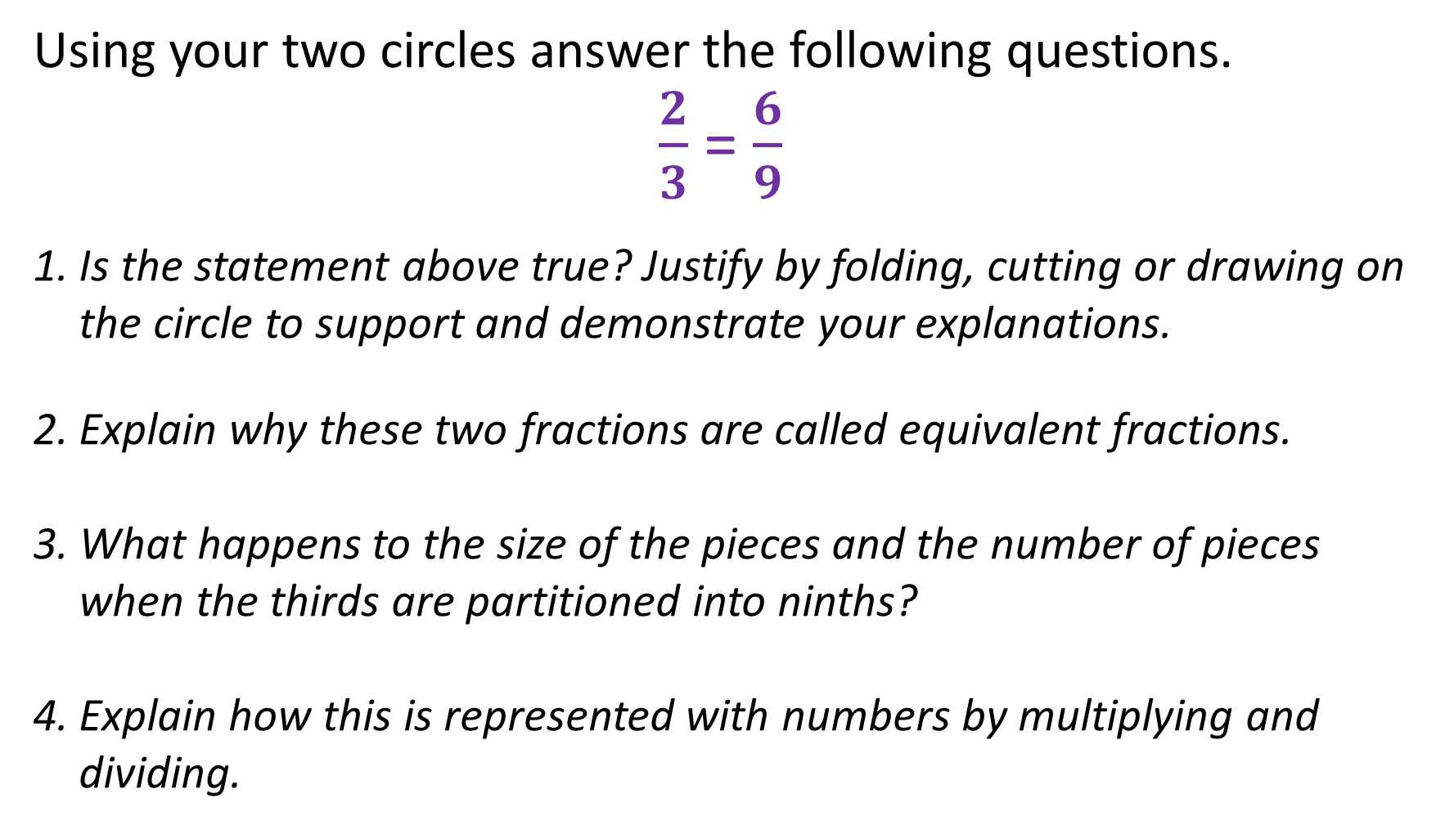
Task
Using your two circles answer the following questions.
$\frac{2}{3}$ = $\frac{6}{9}$
Is the statement above true? Justify by folding, cutting or drawing on the circle to support and demonstrate your explanations.
Explain why these two fractions are called equivalent fractions.
What happens to the size of the pieces and the number of pieces when the thirds are partitioned into ninths?
Explain how this is represented with numbers by multiplying and dividing.
Notes:
Students may explain that the fractions, two thirds and six ninths, represent the same amount or quantity of pizza.
Because two thirds and six ninths are different names for the same amount or number.
Students may explain that when thirds of a pizza are partitioned into ninths, the size of the pieces is three times smaller and the number of pieces is three times larger.
Multiplying the numerator by 3 makes the number of pieces three times greater. Multiplying the denominator by 3 makes each piece three times smaller. Dividing the numerator by three makes the number of pieces three times smaller (or fewer), Dividing the denominator by 3 makes the size of the piece three times larger three times smaller (or greater).

